Slide 1
Employee Data Analysis using Excel
POWERPOINT-PRESENTATION

Slide 2
STUDENT NAME:G.V Hanshiga
NAAN MUDHALVAN ID: asunm1363422200482
REGISTER NO : 422200482
DEPARTMENT : B.com ISM
COLLEGE : Valliammal College For Women

Slide 3

AGENDA
Project Overview
Problem Statement
End Users
Our Solution and Proposition
Dataset Description
Modelling Approach
Results and Discussion
Conclusion

Slide 4

PROJECT OVERVIEW
Analyse the salary of the employee by considering various factors of like Gender , Employee ID, Start date , Employee type , Department ,etc.. We use these in order to identify the trends , patterns of different
categories of employee Salary like very high , high , medium and low .

Slide 5
PROBLEM STATEMENT
Salary analysis refers to the process of examining and evaluating an organization’s salary structure and compensation practices. Salary analysis helps organisations ensure that their compensation practices are fair, competitive, and aligned with both employee expectations and market conditions

Slide 6

WHO ARE THE END USERS ?

Slide 7

OUR SOLUTION AND ITS VALUE PROPOSITION
Conditional formatting : It is a excel feature that is used to apply specific formatting to cells or range of cells in certain criteria.
Sort & filter : It helps to organize and analyse data more effectively.
Pivot table : It is used to summarize and analyse the data.
Chart : It is used to represent the data in visualisation

Slide 8
Dataset Description
Employee dataset :
It is obtained from the edunet dashboard.
It has 11 features.
I have taken 5 features
Employee id: Numerical value
Name: Text type
Gender: Text type
Salary: Numerical values
Start date: Numerical value.

Slide 9
THE "WOW" IN OUR SOLUTION
FORMULA:
We used the formula for salary analysis is: =IFS(Z8>=5,”VERYHIGH”,Z8>=,”HIGH”,Z8>=3 ,”MED”, TRUE,”LOW”)

Slide 10

MODELLING
DATA COLLECTION :
▪Naan mudhalvan .
▪Edunet Dashboard.
FEATURE SELECTION :
▪11 Features.
▪5 Features.
DATA CLEANING :
▪Colour blank values
▪Filter – Remove Blank Values

Slide 11
SALARY LEVEL :
▪ Very High.
▪ High.
▪ Medium.
▪ Low.
PIVOT TABLE :
▪ Employee ID.
▪ Name.
▪ Gender.
▪ Salary.
▪ Salary level.

Slide 12
Start date.
▪ Employee Type.
CHART :
▪ Employee ID.
▪ Name.
▪ Gender.
▪ Salary.
▪ Salary Level.
▪ Start Date.
▪ Employee Type.
▪ Data Visualization.

Slide 13
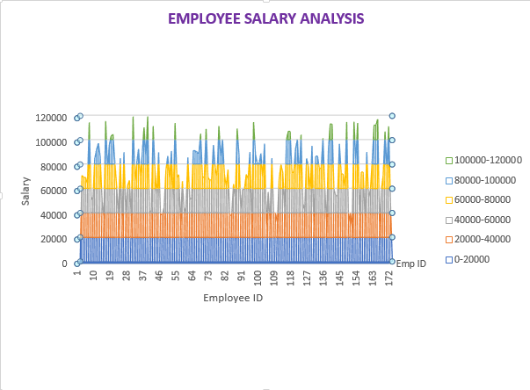
RESULT

Slide 14
conclusion
In this project, I learned who to sort & filter the data, conditional formatting, pivot tables and how to insert charts.

